Slide 1
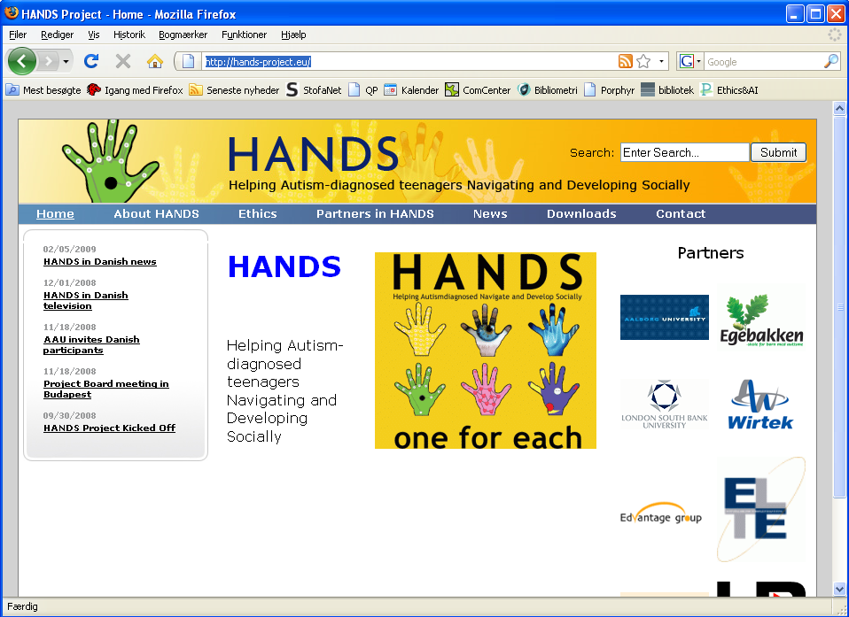
Some Ethical Problems in Hands
Helping Autism-diagnosed teenagers
Navigate and Develop Socially
EU Project: 7TH FRAMEWORK PROGRAMME THEME 7.2
Peter Øhrstrøm
Aalborg University, Denmark
http://hands-project.eu/

Slide 2
The aim of the HANDS project is to
study the potential of persuasive technology as a tool for helping young people with an autism diagnosis
develop mobile ICT solutions that will help young people with autism to become better integrated in society.

Slide 3
No. | Participant acronym | Participant short name | Role | Country
1 | AAU | Aalborg University | Research (Coordinator) | Denmark
2 | WIDK | Wirtek A/S | Dissemination/ marketing | Denmark
3 | WIRU | Wirtek S.R.L | Implementation | Romania
4 | EDV | Edvantage | Requirements | Norway
5 | ELTE | Eötvös Loránd University | Research (psych.) | Hungary
6 | LSBU | London South Bank University | Research (teaching) | UK
7 | NAS | Helen Allison School, NAS | End user | UK
8 | EGE | Egebakken | End user | Denmark
9 | SV | Svedenskolan | End user | Sweden
10 | AF | Autism Foundation | End user | Hungary

Slide 4
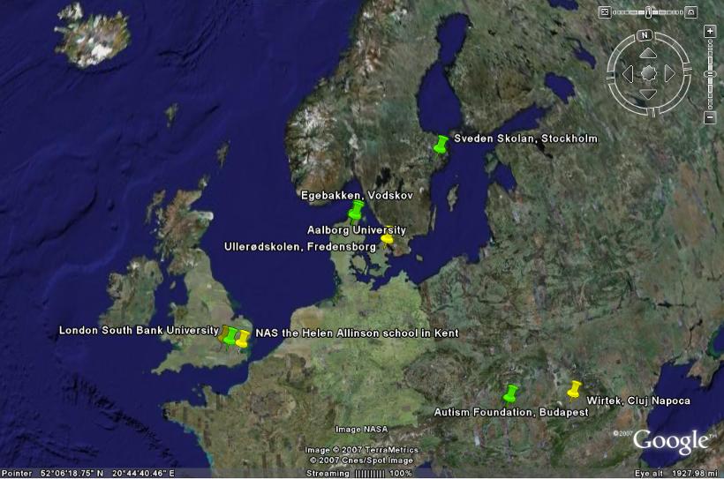
The HANDS – Consortium
Notes:
Researchpartners,, Schoolpartners, Developers. And NAS.Grøn - Underskrevet Letter of Intent, Gul – deltager, Wellformed, but slightly unbalanced(DK)

Slide 5
Participants in Hands:
About 60 teenagers with autism at four schools in four countries – and the parents of the these teenagers.
Teachers at four schools for teenagers with autism.
Reseachers at three universities (Budapest, London and Aalborg).
System developers and programmers at 3 software houses.

Slide 6
Joe is 17 years old, high IQ, with autism, participates in the Hands program.
In co-operation with Joe, his teacher has made several Hands tools, which he can run on his smart phone:
Not to get lost
Not to get angry in the bus
Under consideration:
Not to get into racism
The tools are very helpful for Joe. The use of the tools is stored on the server and gives his teacher useful information.

Slide 7
Teacher working at a school for young people with autism
Teenager with an autism diagnosis and with normal or high IQ

Slide 8
Teacher working at a school for young people with autism
Persuasive
technology
Teenager with an autism diagnosis and with normal or high IQ

Slide 9
Hands toolset – available at the server
Teacher working at a school for young people with autism
Persuasive
technology
Teenager with an autism diagnosis and with normal or high IQ

Slide 10
Hands toolset – available at the server
Teacher working at a school for young people with autism
Persuasive
technology
Teenager with an autism diagnosis and with normal or high IQ

Slide 11
The HANDS toolset
The functionality includes:
The Handy Interactive Persuasive Diary (HIPD).
The Simple-Safe-Success Instructor (SSSI).
The Personal Trainer (TT)
The Individualiser (TIn)
The Sharing Point (SPo)
The Credibility-o-Meter (CoMe)

Slide 12
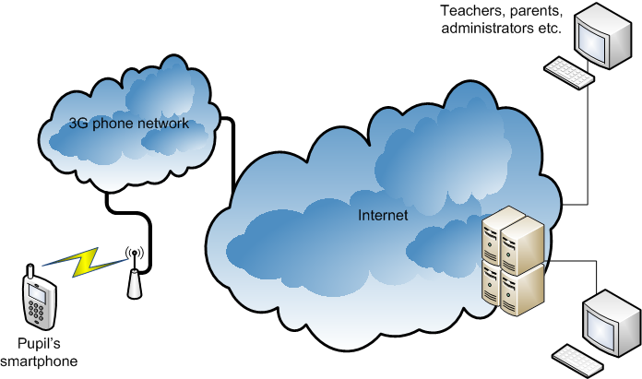
Overview of HANDS tools
HANDS tools consist of:
The Back Hands server
Application designed individually by a teacher running on the smart phone belonging to a teenager.

Slide 13
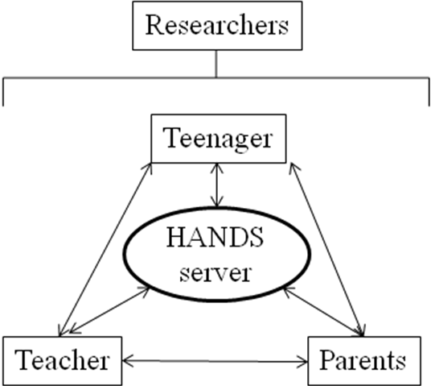
Ethical
Board
Notes:
13

Slide 14
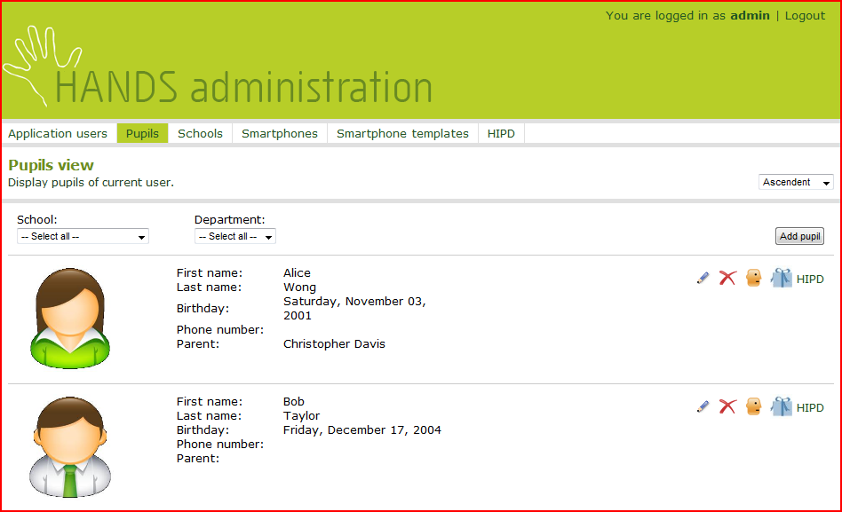
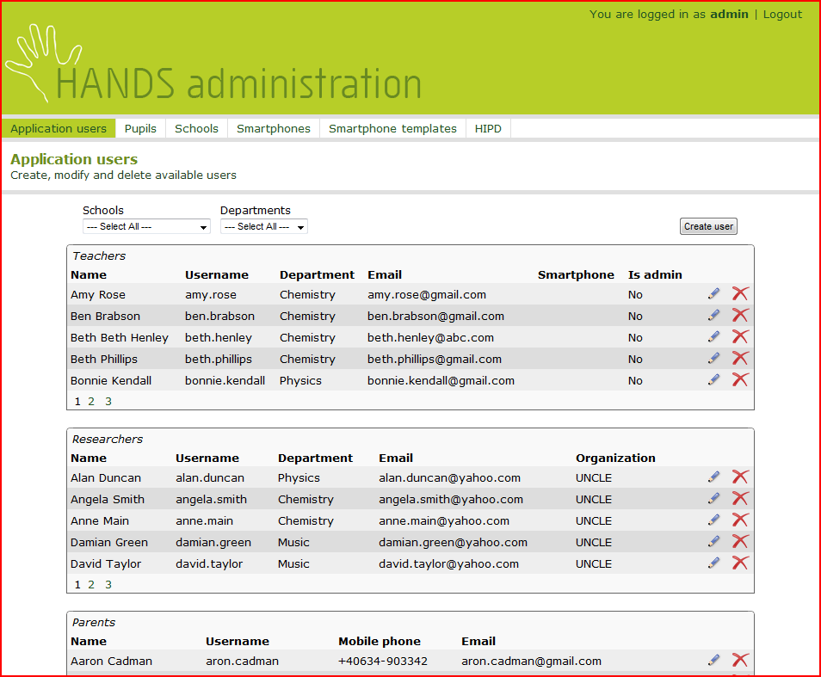
Screen dumps from the Back Hands server

Slide 15
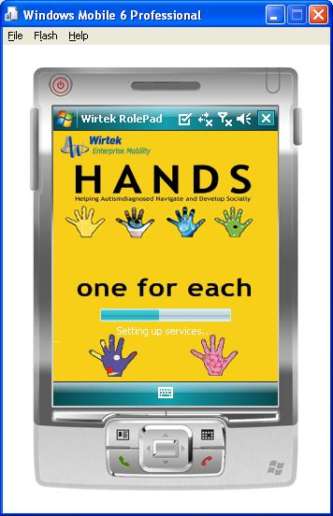
HANDS toolbox on the smart phone
We stick to HANDS values – One for each:
On the smart phone the HANDS tools are collected in one system, and one common interface, called the toolbox.
The toolbox can be adapted to each teenager, so it might look different for each, may have different functionality available etc.

Slide 16
HANDS toolbox on the smart phone
We stick to HANDS values – One for each:
.
The HANDS toolset can be updated from the Back Hands server to each phone belonging to each individual teenager.

Slide 17
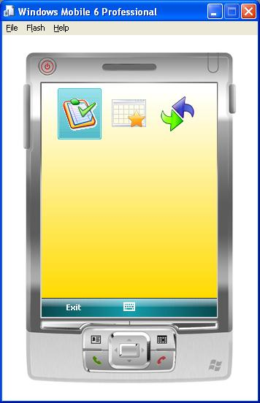
The main menu : The Toolbox
From the Toolbox the teenager may navigate in order to perform different tasks:
Access any tool in his or her toolbox
Synchronize with server

Slide 18
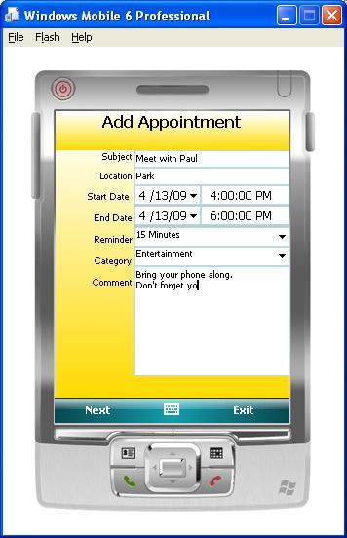
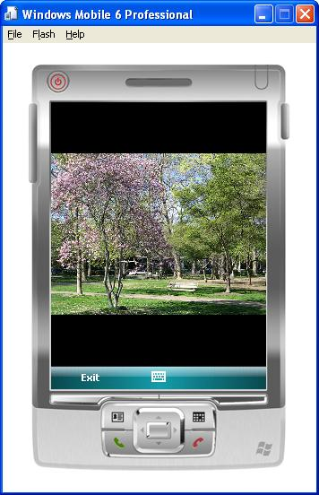
Media
One can view the a media file associated with the appointment or a difficult situation.
Or edit more details on an appointment (below)

Slide 19
The HANDS toolset
The functionality includes:
The Handy Interactive Persuasive Diary (HIPD).
The Simple-Safe-Success Instructor (SSSI).
The Personal Trainer (TT)
The Individualiser (TIn)
The Sharing Point (SPo)
The Credibility-o-Meter (CoMe)

Slide 20
B.J. Fogg,
Persuasive Technology: Using Computers to Change What We Think and Do,
2003
For purposes of captology, I define persuasion as an attempt to change attidues or behaviors or both (without coercion or deception).
Captology focuses on attitude or behavior change resulting from human-computer-interaction (HCI).
p.20

Slide 21
Young people with autism is a vulnerable group. This may give rise to ethical problems.
How should the persuasive intent be communicated to the young people?
How should we handle the possibility of unintended outcomes?

Slide 22
Some ethical questions in HANDS
Is informed consent realistic from teenagers with autism
How much persuasion is acceptable? When will in become manipulation?
What kinds of surveillance of activities and locations are acceptable?
How should person sensitive data stored on the server be treated? Who should have access? When?
It is acceptable to use social software like Facebook as an integrated part of the Hands tools? How should we take care of the risks?

Slide 23
Some ethical questions in HANDS
Is it unethical to take the tools from a teenager for research purposes i.e. as part of the research design?
Are there ethical problems in terminating the server function?
Who is morally responsible if some of the Hands tools turn out to be harmful for some of the teenagers involved in the project? – The teenager, teacher, the school, the software houses, the designers at partner universities, the Hands consortium?

Slide 24
Ethical
Board
There are no simple answers to the ethical questions in Hands. But it is very important to have a continuous debate on ethical challenges among all partners in the project.
Notes:
24

Slide 25
Further readings:
http://hands-project.eu/

Slide 26
Problems regarding informed consent:
What is informed consent?
Who should be asked to give informed consent?
In which cases?
Meta-consent?

Slide 27
Problems regarding ethical boards and panels:
Who should be members of the panel, the board?

Slide 28
Problems regarding ethical boards and panels:
Who should be members of the panel, the board?
What authority should the board/panel be given?

Slide 29
Problems regarding ethical boards and panels:
Who should be members of the panel, the board?
What authority should the board/panel be given?
To what extent can ethical issues be discussed rationally?

Slide 30
Gerdes, A., & Øhrstrøm, P. (2015). Issues in robot ethics seen through the lens of a moral Turing Test. Journal of Information, Communication and Ethics in Society, 13(2), 98-109.
Aagaard, M., & Øhrstrøm, P. (2012). Developing Persuasive Technology for ASD Challenged Teenagers. In Persuasive Technology: Design for Health and Safety: 7th International Conference, PERSUASIVE 2012, Linköping, Sweden, June 6-8, 2012. Proceedings. (Vol. 7284, 67-78). Springer Publishing Company. (Lecture Notes in Computer Science; Nr. 7284).
Øhrstrøm, P. (2011). Helping Autism-diagnosed Teenagers Navigate and Develop Socially Using
E-learning Based on Mobile Persuasion. International Review of Research in Open and Distance Learning, 12(4), 54-71.
Gerdes, A., & Øhrstrøm, P. (2011). The Role of Credibility In the Design of Mobile Solutions
To Enhance the Social Skill-Set of Teenagers Diagnosed with Autism. Journal of Information,
Communication and Ethics in Society, 9(4), 253-264. DOI: 10.1108/14779961111191057
Øhrstrøm, P., & Dyhrberg, J. (2007). Ethical problems inherent in psychological research
based on internet communication as stored information. Theoretical Medicine and Bioethics, 28(3), 221-241.
Jespersen, J. L., Albrechtslund, A., Øhrstrøm, P., Hasle., P. F. V., & Albretsen, J. (2007). Surveillance, Persuasion, and Panopticon. I Y. de Kort, W. IJsselsteijn, C. Midden, B. E., & B. J. Fogg (red.), Persuasive Technology: Second International Conference on Persuasive
Technology, PERSUASIVE 2007 : Revised Selected Papers, pp. 109-120). IEEE Computer Society
Press. (Lecture Notes in Computer Science, Vol. 4744/2007).

