Slide 1
Ethical Argumentation
- Moral reasoning
Peter Øhrstrøm
AAU

Slide 2
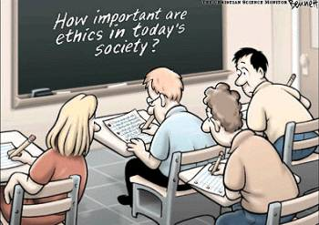
The Main Forms of Moral Reasoning
Reasoning from Virtue: Ontological Reasoning
Reasoning from Rules: Deontological Reasoning
Reasoning from Consequences: Teleological Reasoning

Slide 3
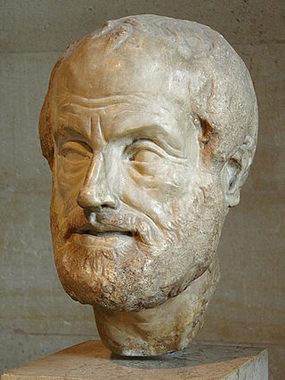
Reasoning from Virtue: Ontological Reasoning
In my life I should focus more on my ethical character and general behaviour as such than on particular acts. It is important to develop ethical qualities, virtues.
Aristotle (384-322 B.C.)
Much Christian thinking in Europe.

Slide 4
Reasoning from Virtue: Ontological Reasoning
The cardinal virtues
1. Prudence
2. Justice
3. Temperance
4. Courage
5. Faith
6. Hope
7. Love
Aristotle (384-322 B.C.)
Much Christian thinking in Europe.

Slide 5
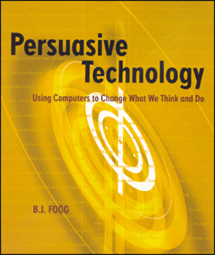
BJ. Fogg
Designers should be responsible and hopefully even praiseworthy in their work.
What does that mean?

Slide 6
Design ethics
Notes:
6

Slide 7
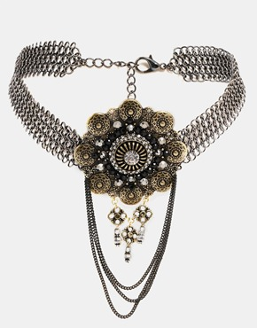
Major premise: I aspire to be an honest person, I hate the
idea of being a thief.
Minor premise: Taking this necklace makes me a thief.
Conclusion: Therefore I may not take this necklace.
Reasoning from Virtue

Slide 8
Major premise: Thou shalt not steal.
Minor premise: To take this necklace would be stealing.
Conclusion:
Thou (in this case, I) may not take the necklace.
Deontological Reasoning

Slide 9
Deontological Reasoning
Here ethics is cased on a set of laws or commandments (i.e. the 10 commandments).
E.g.
Thou shalt not kill
Thou shalt not steal
The great commandment: Love your neighbour as yourself.
Relation between moral and legal laws?

Slide 10
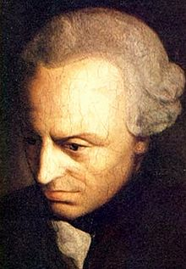
The first formulation of the Categorical Imperative :
"Act only in accordance with that maxim through which you can at the same time will that it become a universal law."
This formulations appears similar to The Golden Rule:
1) "Do not impose on others what you do not wish for yourself."
2) "Treat others how you wish to be treated".
Immanuel Kant (1724-1804)

Slide 11
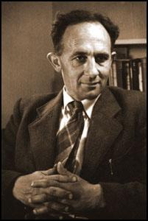
A.N. Prior discussed the logical machinery involved in the theoretical derivation of obligation. He wanted to find what he called “The Logic of Obligation”.
Prior claimed that such logical system had to be based on complete descriptions of
(a) the actual situation, and
(b) the relevant general moral rules.
Arthur Norman Prior
(1914-69)

Slide 12
~A not permitted
~A forbidden
A obligatory
A not permitted
A forbidden
~A obligatory
~P~A
OA
~PA
O~A
A permitted
A not forbidden
~A not obligatory
~A permitted
~A ikke forbidden
A not obligatory
PA
~O~A
P~A
~OA

Slide 13
A.N. Prior discussed the logical machinery involved in the theoretical derivation of obligation. He wanted to find what he called “The Logic of Obligation”. Prior claimed that such a logical system had to be based on complete descriptions of
(a) the actual situation, and
(b) the relevant general moral rules.
Prior’s fundamental creed regarding deontic logic:
“... our true present obligation could be automatically inferred from (a) and (b) if complete knowledge of these were ever attainable” (Prior 1949)
This makes the idea of a full deontic system rather unrealistic!

Slide 14
Deontological Reasoning - dilemmas
Ex: Jews hidden in the attic & Gestapo asking questions at the door.
Ex: In some case you may only be able to feed you children if you steal.

Slide 15
Major premise: If everyone took objects that don't belong to them, all trust in institutions would break down and the economy would collapse; therefore the practice of unauthorized taking objects is contrary to the greatest good of the society;
Minor premise: Taking this necklace in these circumstances would therefore be contrary to the greatest good of the society;
Conclusion: This act is not right and I should not do it.
Reasoning from Consequences

Slide 16
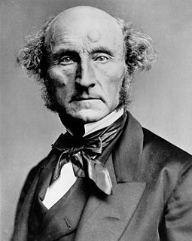
Reasoning from Consequences (utilitarism)
This means that you should do what leads to greatest happiness of the greatest number of persons in society.
Problems:
1) What units should be used?
2) Who should be included in the calculation?
John Stuart Mill (1806-73)

Slide 17
BJ Fogg’s diagram:
If the
is
and
and
then the desig- ner is
Outcome
Intended
Unintended
Reasonably
predictable
Not reasonably
predictable
Ethical
Unethical
Ethical
Unethical
Ethical
Unethical
Praise-
worthy
Respon-sible
and at fault
Not
respon-sible
Respon- sible
and at fault
Not
respon-sible
Respon-sible
and at fault

Slide 18
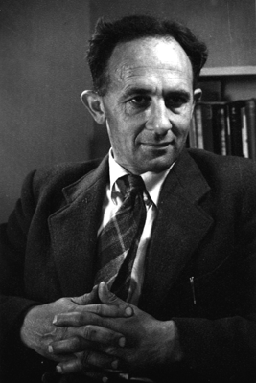
A.N. Prior’s criticism of consequentialism.
G.E. Moore’s definition of ‘duty’ in Principia Ethica :
“Duty is that action which, of all the alternatives open to us, will have the best total consequences.”
A.N. Prior
(1914-69)

Slide 19
Prior’s main criticism of Moore’s definition:
Then there may indeed be a number of alternative actions which we could perform on a given occasion, but none of these actions can be said to have any ‘total consequences’, or to bring about a definite state of the world which is better than any other that might be brought about by other choices. For we may presume that other agents are free beside the one who is on the given occasion deciding what he ought to do, and the total future state of the world depends on how these others choose as well as on how the given person chooses… [Prior 1968, p.51]

Slide 20
For want of a nail
The shoe was lost;
For want of a shoe
The horse was lost;
For want of a horse
The rider was lost;
For want of a rider
The battle was lost;
For want of a battle
The kingdom was lost;
And all for the want
Of a horse-shoe nail.
A.N. Prior
(1914-69)

Slide 21
Prior’s main criticism of Moore’s definition:
Then there may indeed be a number of alternative actions which we could perform on a given occasion, but none of these actions can be said to have any ‘total consequences’, or to bring about a definite state of the world which is better than any other that might be brought about by other choices. For we may presume that other agents are free beside the one who is on the given occasion deciding what he ought to do, and the total future state of the world depends on how these others choose as well as on how the given person chooses… [Prior 1968, p.51]

Slide 22
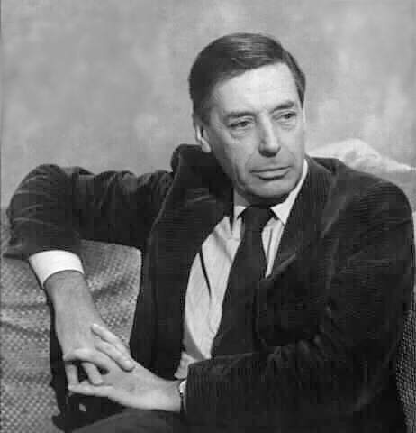
Jim comes across 20 innocent prisoners about to be executed. Their captor says that if Jim will shoot one of the prisoners, he will let the rest of them go free. Jim dislikes this idea, but the prisoners are begging him to accept. What should he do?
Bernard Williams
(1929-2003)

Slide 23
Deontological Reasoning
Reasoning from Consequences
Reasoning from Virtue

Slide 24
Ethics
Utilitarianism:
Analysis of consequences

Slide 25
Ethics
Utilitarianism:
Analysis of consequences
Deontology:
Analysis of rules of obligation.

Slide 26
Ontology:
Analysis of the concrete situation.
Ethics
Utilitarianism:
Analysis of consequences
Deontology:
Analysis of rules of obligation.

Slide 27
Ethical questions concerning data collection:
In which cases is it ethically acceptable to develop/use flying robots that can perform various kinds of surveillance and data collection in specific contexts?
Is it ethically acceptable the collect person sesitive data without obtaining informed consent? If so, who should be allowed to do it?
To what extent should the individual be able to claim privacy?
In which cases should we use informed consent?
In which cases should we use ethical boards or panels?

Slide 28
Surveillance in domotics
Surveillance in health care (EPR).
Surveillance in searching
Surveillance and metadata
Etc.
How can be deal with the problem that the use of data extracted from databases is sometime caught between the societal “right to know” and the individual “right to private life”?
Notes:
Prejudicial = pre-j&-'di-sh&l

