Slide 2

The Enterprise Architecture of Organised Crime
Presented by Simon Polovina
Enterprise Architect
October 2016

Slide 3
Overview
eARLY PURSUIT AGAINST ORGANIZED CRIME USING ENVIRONMENTAL SCANNING THE LAW AND INTELLIGENCE SYSTEMS
About the project
Software Features
The role of data, modelling and knowledge representation
Enterprise Architecture
…and Organised Crime
Observations
Summary and Questions

Slide 4
ePOOLICE explores how situational awareness and open source intelligence can be used to detect organised crime threats, both current and emerging, their movements and variations

Slide 5
The Perfect Indicator
Alice says:
"Bob, I'll meet you on Foo Lane, 5pm, Saturday to sell you that cocaine."

Slide 6
Weak Indicators
"A drug dealer from Sheffield has been jailed after police found a stash of skunk cannabis at his house."

Slide 7
Weak Indicators
"A drug dealer from Sheffield has been jailed after police found a stash of skunk cannabis at his house."
Person
Location
Organisation
Drug
Location

Slide 8
Model Based Entity Extraction
Drug Trafficking
Metal Theft
Human Trafficking
Young Staff
Blackout Curtains
Cheap Prices
Poor Service
Begging
High Visitor Volume
Cash Only
Out of Hours
Commuter Delays

Slide 9
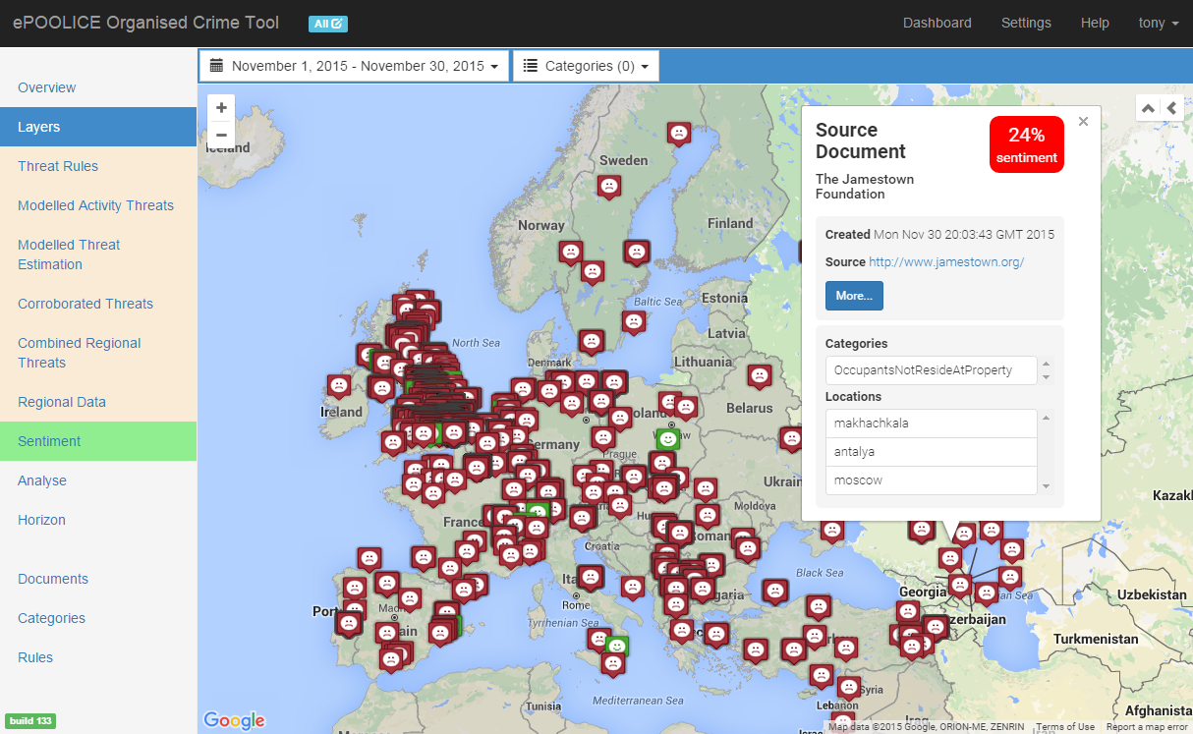
Document Overview
Potentially
multiple
locations
Indicators &
attributes
Sentiment
identified

Slide 10
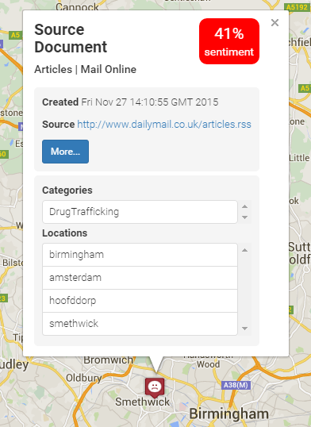
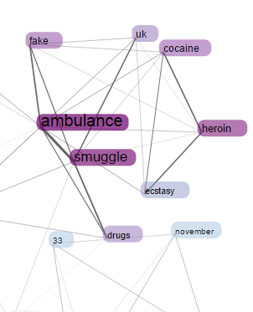
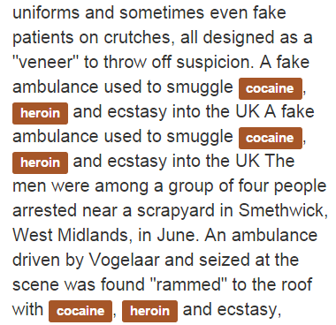
Exploring Individual Documents

Slide 11
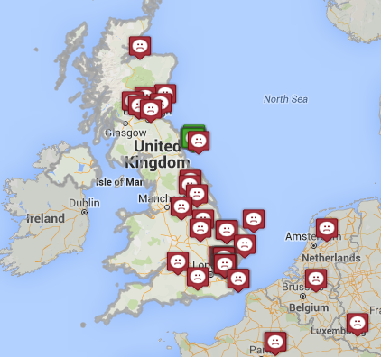
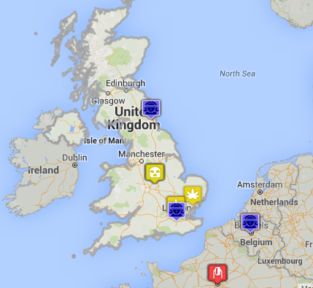
Reducing Noise by Corroboration
Reduce Noise

Slide 12
Corroborated Threats
An Article
Cocaine
Sheffield
A Report
Sheffield
Crewe
A Tweet
Nightclub
Sheffield
London
Cocaine
Others
Coke
Sheffield
Cocaine
Threat Concept
Others
Others
3 Sources
2 Attributes

Slide 13
Some Quirks
For example: Location resolution can be tricky
Pick any word you can imagine, it's likely a place!
The common ones we see:
Over
UK
Police
Poland
Sale
UK
Buy
Russia
God
Turkey
One
Italy

Slide 14
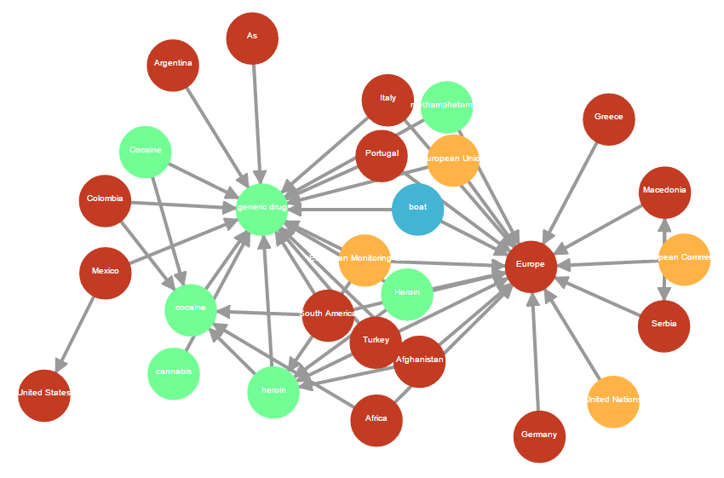
Association Rules (& pointing to Business Organisation of OC)
Transport Methods
Drugs
Organisations
Locations

Slide 15
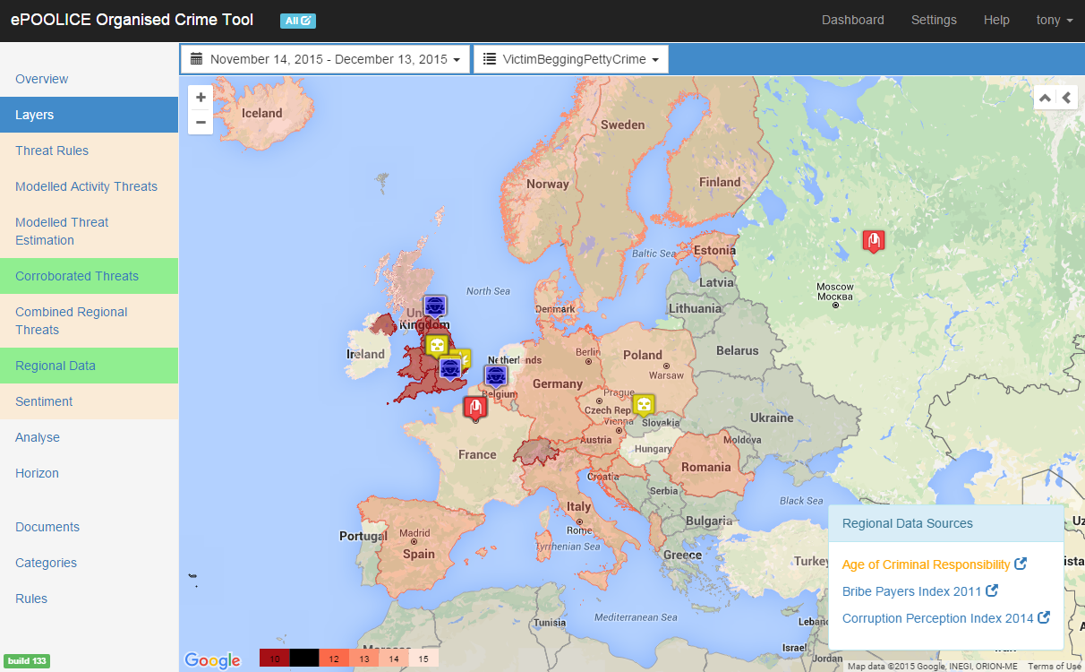
Regional Overlays
Age of Criminal Responsibility
Sub-Regional

Slide 16
Information Flow and role of Enterprise Architecture
The EA model is here!
Raw Data
Feedback
News
Processing
Social media
Reports
Aggregation
Categorisation
Filtering
Visualisations
Maps
Timelines

Slide 17

Architecting the Business (Enterprise) of OC

Slide 18
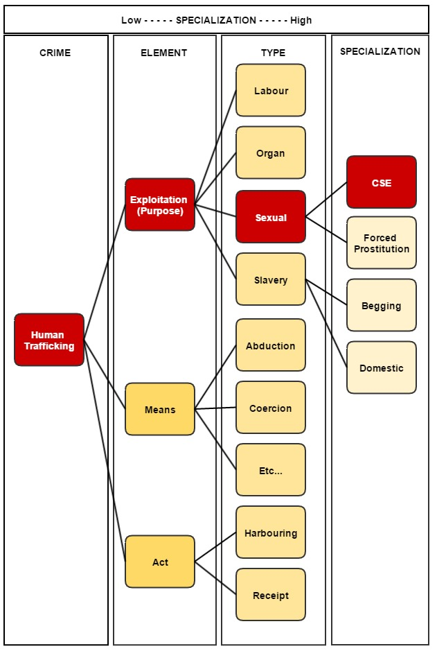
An OC Taxonomy
A Taxonomy of Organised Crime:
Categorisation &
Specialisation
Andrews, Brewster and Day (2016)
Notes:
CSE is Child Sex Exploitation

Slide 19
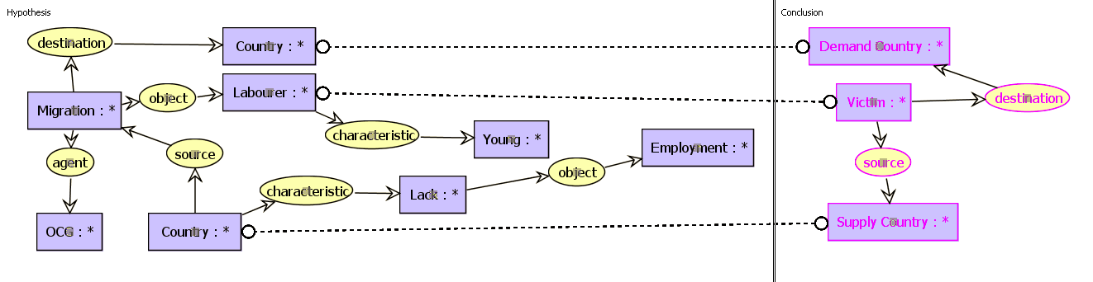
Knowledge Representation of OC (in Conceptual Graphs)
Brewster, Polovina et al. (2014), 2 papers
Modelled using CoGui (http://www.lirmm.fr/cogui/)
Rule: Victim Transit Route
  Visualise implied knowledge "if-then" scenario
  Aggregation of weak signals can contribute to providing tangible indicators of OC activity

Slide 20
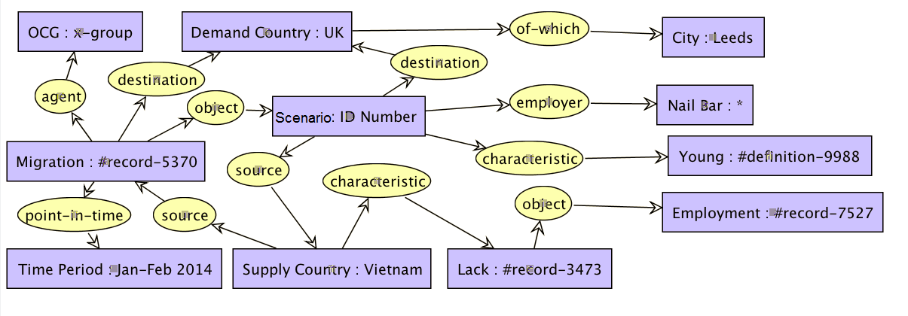
Knowledge Representation: Conceptual Graphs
Fact: Representation of a specific 'known' scenario

Slide 21
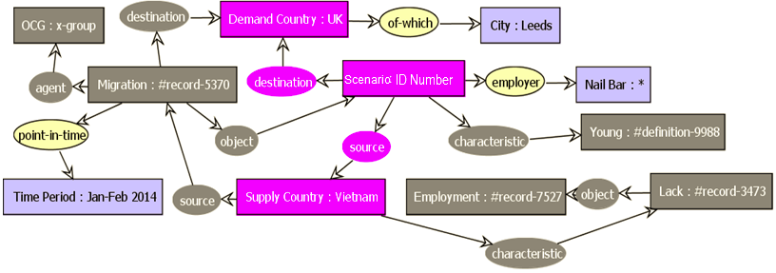
Knowledge Representation: Conceptual Graphs
Rule projected inside the fact - Validation of 'if-then' rule

Slide 22
Use Case: UNODC THB Scenario
In the recent North European case, the defendant was an EU citizen. He was indicted and convicted for subjecting four victims, including two EU nationals, to forced labour. The indictment was that, prior to August 2007, the defendant together with his brother recruited several persons in the EU. These people were in a vulnerable situation because they were either homeless, mentally disabled, without work or income. The defendant exploited them through the use of a very strict regime and utilized violence and threats to force the victims to perform work in the form of asphalting and stone laying. The victims did not have any real and acceptable opportunity to terminate the employment relationship. The work was exceedingly badly paid, wherein the victims received less pay than originally agreed, were obliged to live under wretched conditions, had sometimes extremely long workdays, and were under constant surveillance and told or given the impression that if they failed to perform the work or ran away, they would be fetched back, beaten or killed.
- (UNODC, 2009)
UNITED NATIONS OFFICE ON DRUGS AND CRIME (UNODC), 2009. Anti-Human Trafficking Manual for Criminal Justice Practitioners.

Slide 23
Use Case: UNODC THB Scenario
In the recent North European case, the defendant was an EU citizen. He was indicted and convicted for subjecting four victims, including two EU nationals, to forced labour. The indictment was that, prior to August 2007, the defendant together with his brother recruited several persons in the EU. These people were in a vulnerable situation because they were either homeless, mentally disabled, without work or income. The defendant exploited them through the use of a very strict regime and utilized violence and threats to force the victims to perform work in the form of asphalting and stone laying. The victims did not have any real and acceptable opportunity to terminate the employment relationship. The work was exceedingly badly paid, wherein the victims received less pay than originally agreed, were obliged to live under wretched conditions, had sometimes extremely long workdays, and were under constant surveillance and told or given the impression that if they failed to perform the work or ran away, they would be fetched back, beaten or killed.
- (UNODC, 2009)
UNITED NATIONS OFFICE ON DRUGS AND CRIME (UNODC), 2009. Anti-Human Trafficking Manual for Criminal Justice Practitioners.
Notes:
With key terms that have been highlighted, becoming indicators and concepts in the Conceptual graph.

Slide 24
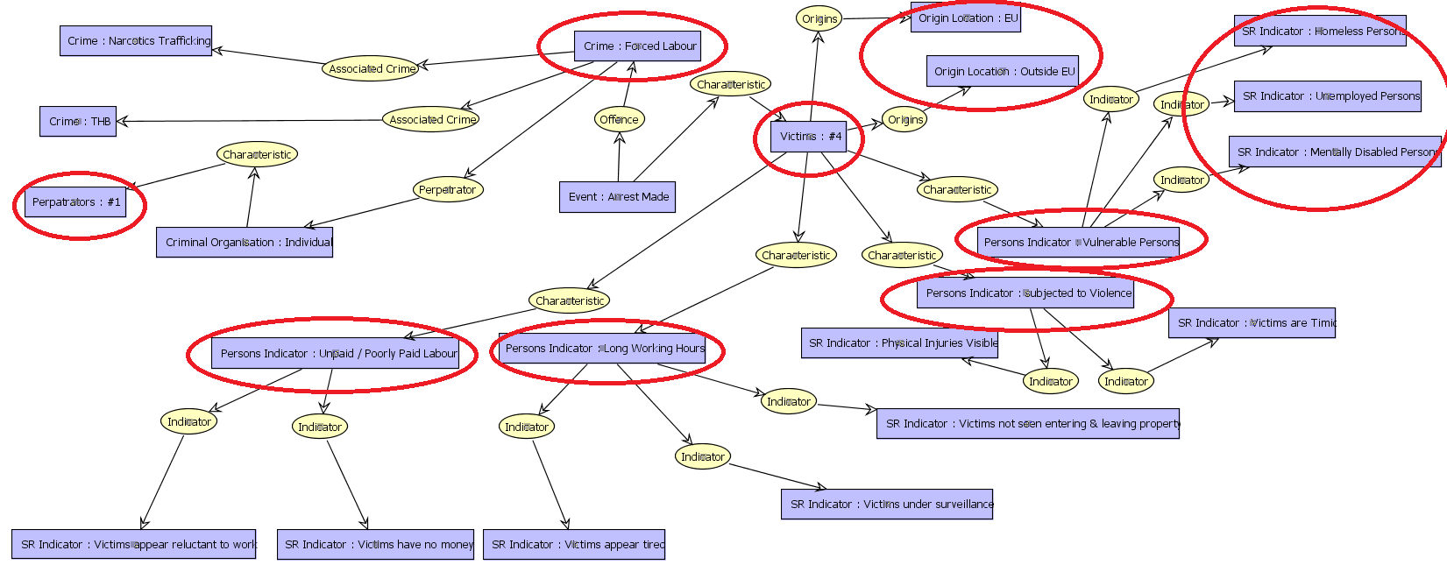
Modelling the Scenario in CoGui: Representing Knowledge
Knowledge from case study modelled, ontological relationships identified
Notes:
Modelling an 'operational' event such as this can provide indicators of a new emergent threat, such as the use of a new, previously unknown trafficking route.
Key concepts / indicators from the case study scenario have been ringed in red.
Additional indicators / and relationships added for 'colour' to give a more complete scenario.
Could talk through scenario.
I.E.
Victim Characteristic: Arrested
Arrest caused by offence: Forced Labour
Forced Labour perpetrated by: Individual
Characteristic of the individual: #1 perp
OR
Characteristic of the arrest: #4 Victims
Characteristic of the Victims: Vulnerable people
Indicators of vulnerability: unemployed, homeless, psychological disability
etc. etc. Building up a ontological understanding of the event.

Slide 25
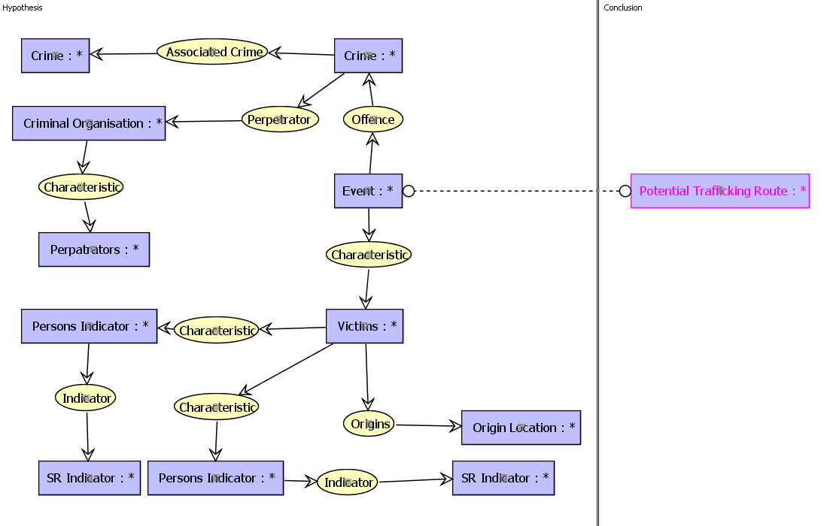
Modelling the Scenario: Hypothesis / Conclusion
Accumulation of these events: Potentially a new trafficking route!
Notes:
this can then be abstracted, context removed and form the basis of a rule in the EKR.

Slide 26
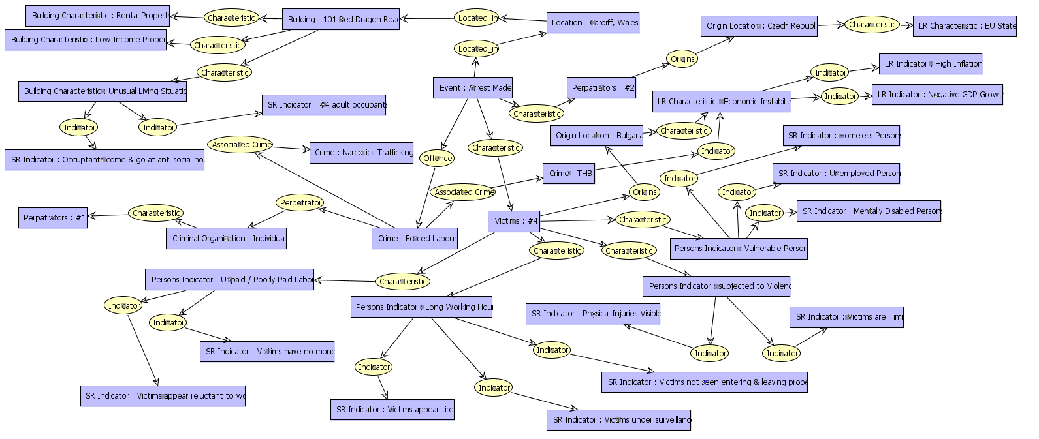
Expanding the Scenario
Scenario combined with additional, specialist domain knowledge for long range radar.
Notes:
Scenario can then be embedded within additional specialist domain knowledge within the EKR, and relationships between the scenario and potential 'long range' indicators and characteristics identified.
i.e (top right hand corner of the CG)
High inflation, low GDP growth and both indicators of Economic instability, which itself is a current indicator of Bulgaria (for the purposes of the example)

Slide 27
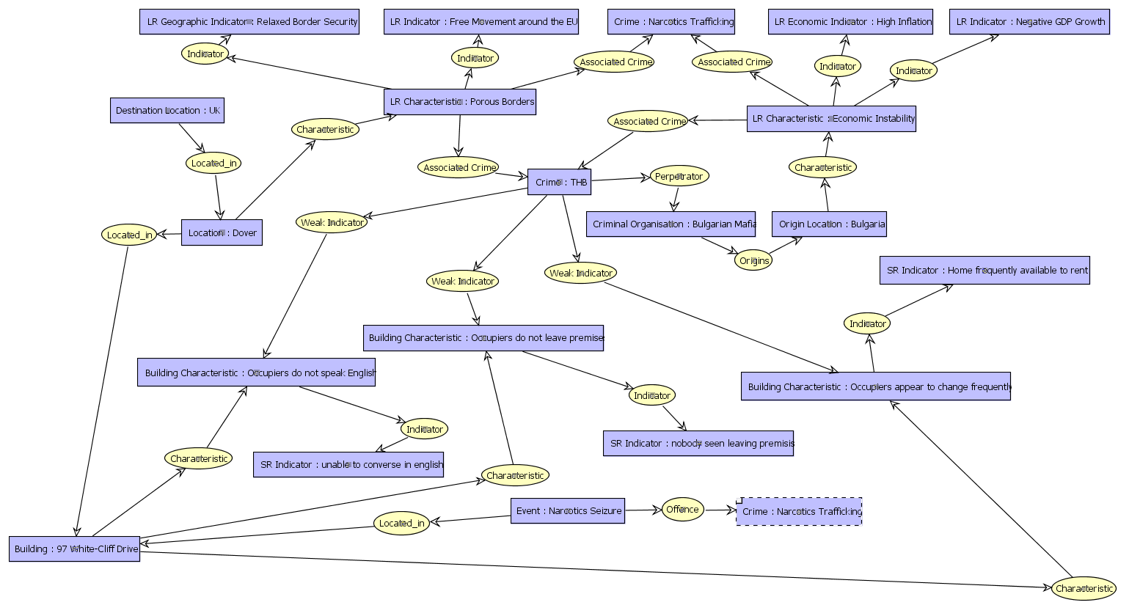
Narcotics Trafficking Scenario
Similar logic can be applied to a Cocaine trafficking scenario:
Notes:
fabricated Cocaine trafficking case. Same logic as previous slide.

Slide 28




Identifying the Indicators (WP5 & SAS)
Using SAS to identify the Indicators of this activity from open-source intelligence repositories:
  Using SAS Enterprise Content Categorization
  Open sources crawled using SAS Information Retrieval Studio

Slide 29
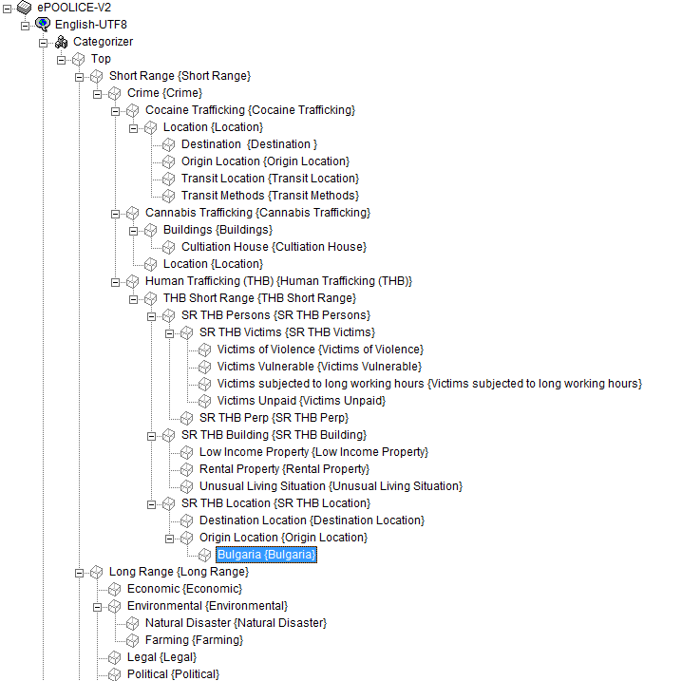
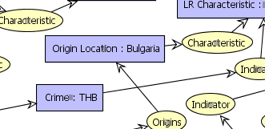
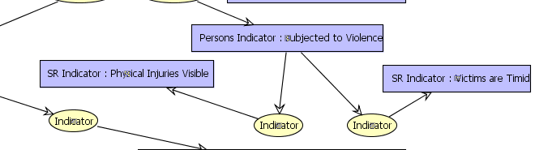
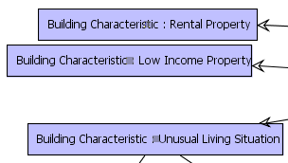
Translation into a Taxonomy of Categories
The concepts defined in the conceptual graphs in CoGui are reflected in the SAS Content Categorization Taxonomy.
Notes:
Shows how concepts are reflected in SAS CC taxonomy for categorizing concepts. [NB it’s an earlier version and shown simply to illustrate a mapping from CG into other tools; here it’s a Translation into a Taxonomy of Categories in SAS for ePOOLICE. But could be into other semantic technologies such as RDF(S), which CoGui supports.]

Slide 30
Reminder: Architecting the Business (Enterprise) of OC

Slide 31
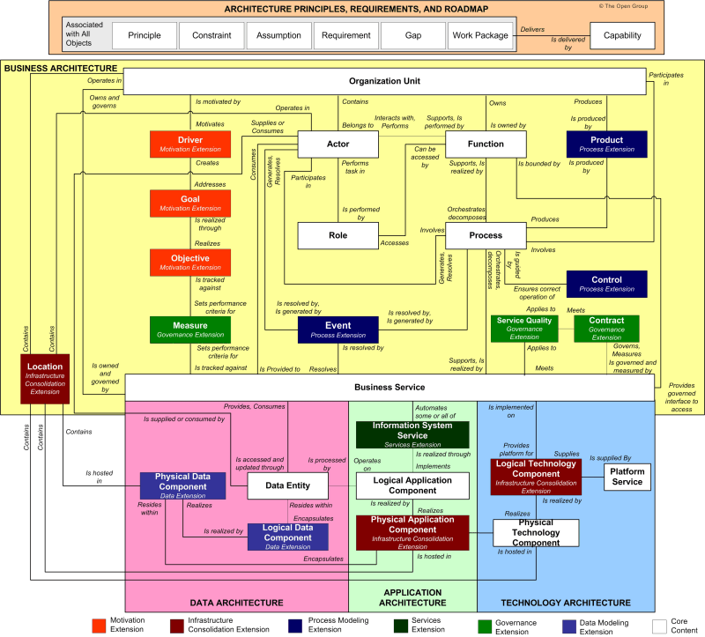
TOGAF Content MetaModel (Basis for OC Taxonomy)

Slide 32
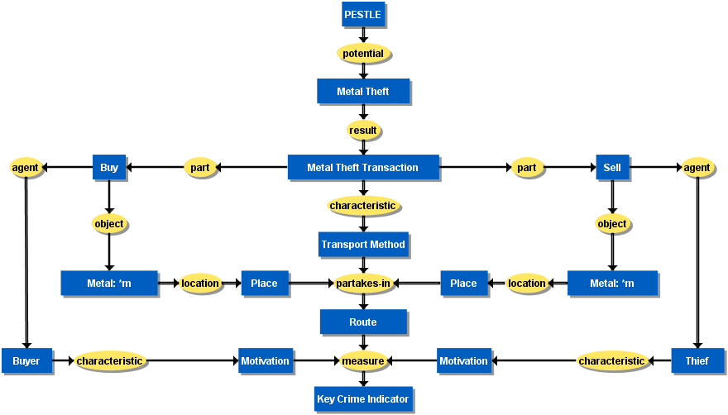
MT Taxonomy (Ontology)

Slide 33
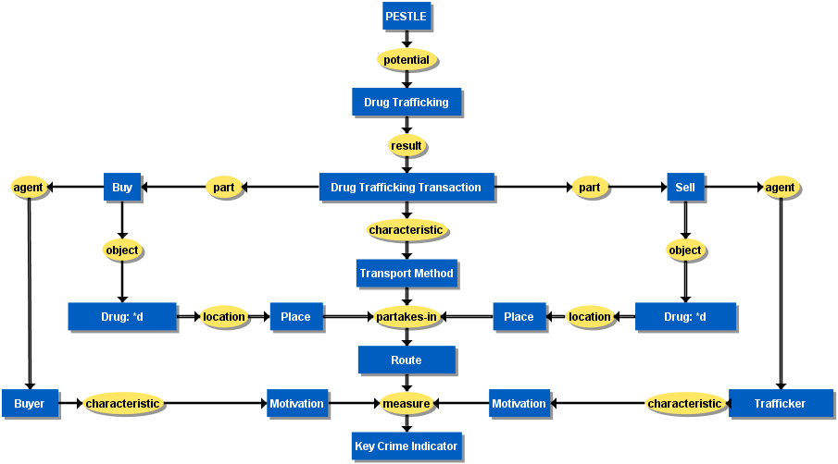
DT Taxonomy (Ontology)

Slide 34
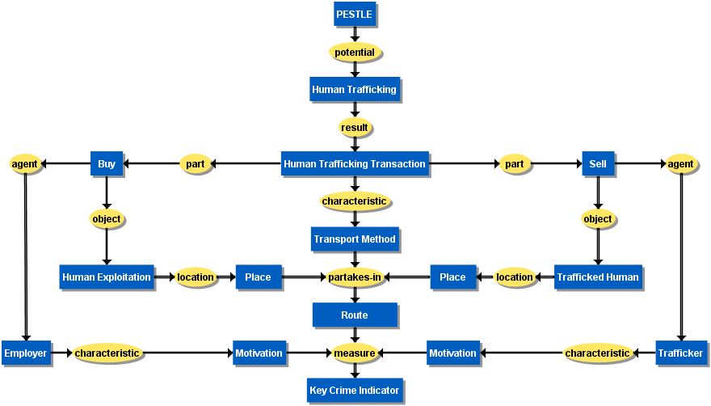
THB Taxonomy (Ontology)

Slide 35
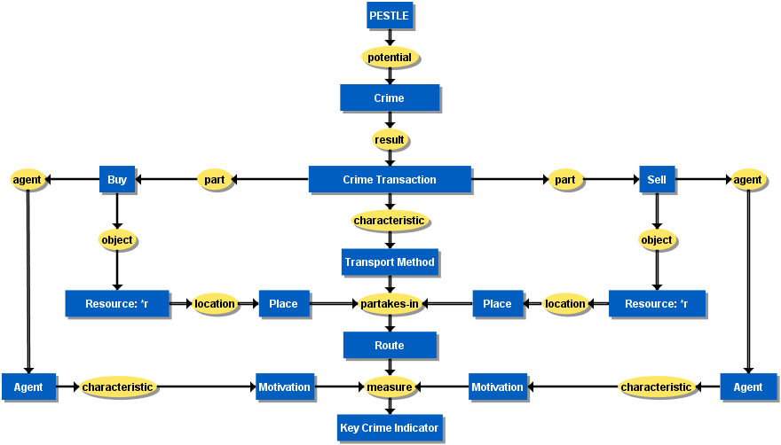
OC (i.e. Overall) Taxonomy (Ontology)

Slide 36
Link to Expert’s Models
Advertising → drives → Buy & Sell
Premises ← Place
Transportation ← Transport Method
Communication ← (Economic) Resource
Finance ← (Economic) Resource
Culture ← S in PESTLE → drives → Crime
Trigger ← driven-from ← Motivation

Slide 37
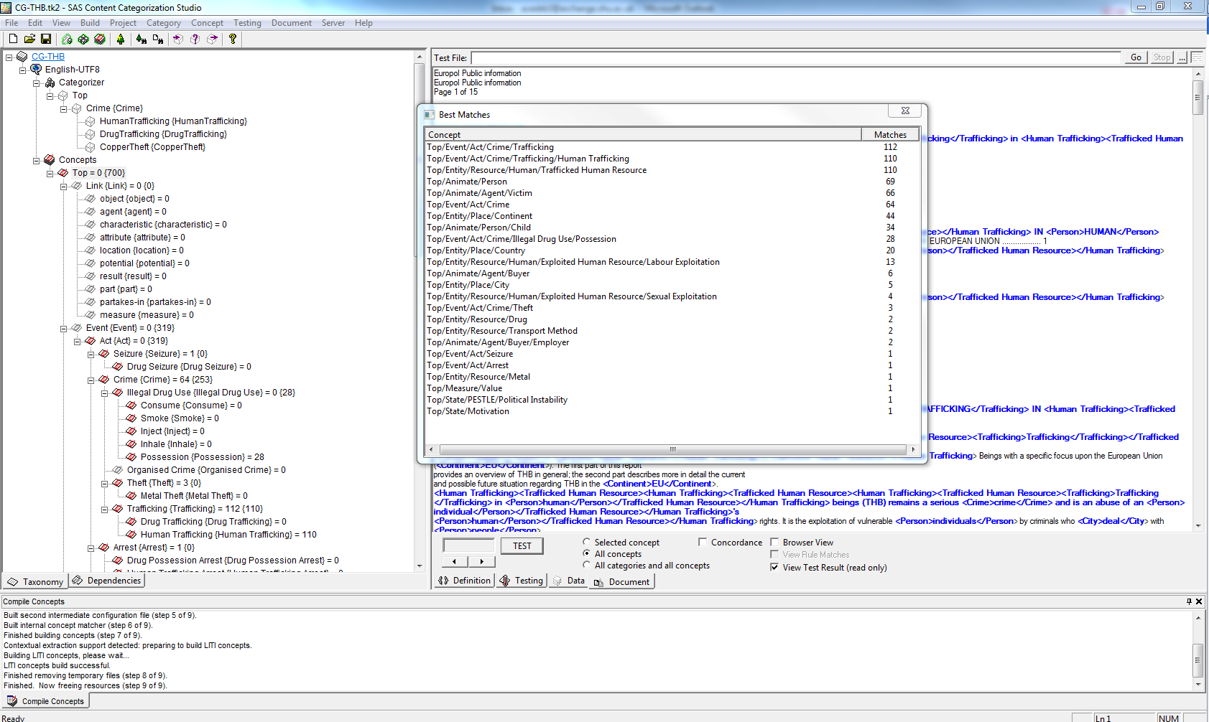
SAS Content Categorization Studio

Slide 38
Taxonomy
Top
Animate {Animate}
Agent {Agent}
Buyer {Buyer}
Employer {Employer}
Thief {Thief}
Trafficker {Trafficker}
Victim {Victim}
Person {Person}
Adult {Adult}
Child {Child}
Entity {Entity}
Business {Business}
Place {Place}
City {City}
Continent {Continent}
Country {Country}
Resource {Resource}
Drug {Drug}
Trafficked Drug {Trafficked Drug}
Human {Human}
Exploited Human Resource {Exploited Human}
Domestic Servitude {Domestic Servitude}
Forced Criminality {Forced Criminality}
Labour Exploitation {Labour Exploitation}
Internal Trafficking
Sexual Exploitation {Sexual Exploitation}
Trafficked Human Resource {Trafficked Human Resource}
Metal {Metal}
…

Slide 39
Where it Maps

Slide 40
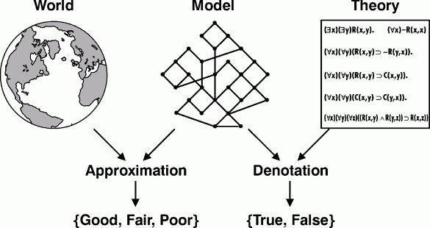

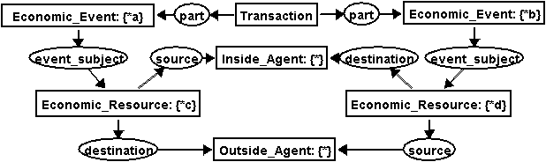
About Models - “All models are wrong, but some are useful”
The Real World
Modelling it
Theory from it
(After George Box)
2014/15
AEA Box
39

Slide 41
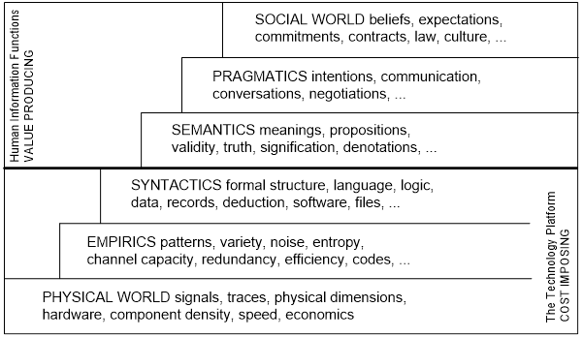
Stamper (1996)’s Semiotic Ladder

Slide 42
Knowledge Management in Enterprise Architecture
Knowledge Capture / Creation
Knowledge Sharing / Dissemination
Knowledge Application
Key Considerations for
technological approach
  Knowledge Availability
  Practical application of that knowledge
  Mechanisms to disseminate it
Organisation
Culture & Ethics
Technology
Knowledge Culture!
Technology is only one component of effective enterprise architecture
  Requirement to effectively consider and integrate technology and organisation structures with culture and ethics in an overall information (enterprise) architecture

Slide 43
References
Andrews, Simon; Brewster, Benjamin; Day, Tony (2016). Organised Crime and Social Media: Detecting and Corroborating Weak Signals of Human Trafficking Online. In: Haemmerlé, Ollivier, Stapleton, Gem and Faron-Zucker, Catherine, (eds.) Graph-based representation and reasoning. Lecture notes in computer science (9717). Heidelberg, Springer, 137-150.
Brewster, Ben; Polovina, Simon; Rankin, Glynn; Andrews, Simon (2014) Knowledge Management and Human Trafficking: Using Conceptual Knowledge Representation, Text Analytics and Open-Source Data to Combat Organized Crime, In: Hernandez, Nathalie; Jäschke, Robert; Croitoru, Madalina (Eds.), Graph-Based Representation and Reasoning, Lecture notes in computer science (8577), Heidelberg, Springer, 104-117.
Brewster, Ben; Andrews, Simon; Polovina, Simon; Hirsch, Laurence; Akhgar, Babak (2014) Environmental Scanning and Knowledge Representation for the Detection of Organised Crime Threats, In: Hernandez, Nathalie; Jäschke, Robert; Croitoru, Madalina (Eds.), Graph-Based Representation and Reasoning, Lecture notes in computer science (8577), Heidelberg, Springer, 275-280.
Stamper, R. (1996). Signs, Norms, and Information Systems. In B. Holmqvist, Signs at Work (pp. 349-397). Berlin, Germany: Walter de Gruyter.

Slide 44
Summary
Overview
About the project
Software Features
The role of data, modelling and knowledge representation
Enterprise Architecture
…and Organised Crime
Observations

Slide 45
Thank you! Questions?

