Slide 1
Privacy
What is it good for?

Slide 2
Privacy is an important ICT issue – ”None is more paradigmatic than the issue of privacy” (Moor, 1997)

Slide 3
Intrinsic and Instrumental value
"we call that which is in itself worthy of pursuit more final than that which is worthy of pursuit for the sake of something else, and that which is never desirable for the sake of something else more final than the things that are desirable both in themselves and for the sake of that other thing, and therefore we call final without qualification that which is always desirable in itself and never for the sake of something else.“ (Aristotle Nicomanean Ethics, Book 1, §7)

Slide 4
Intrinsic value?
If x is an essential part of an intrinsic good, then x is also an intrinsic good.
Privacy is an essential part of autonomy
Autonomy is an intrinsic good
Hence privacy is an intrinsic good.

Slide 5
“In this thought experiment Tom is very good with computers and electronics and has a real fondness for knowing about you – all about you. Tom uses computers secretly to search your financial records, your medical records, and your criminal records. He knows about your late mortgage payments, your persistent hemorrhoids, and that driving-while-intoxicated charge that you thought was long forgotten. Tom is so fascinated with your life that he has clandestine cameras installed which record your every movement. You know nothing about any of this, but Tom, watching your life is like following a soap opera – The Days of Your Life.” (Moor, 1997)

Slide 6
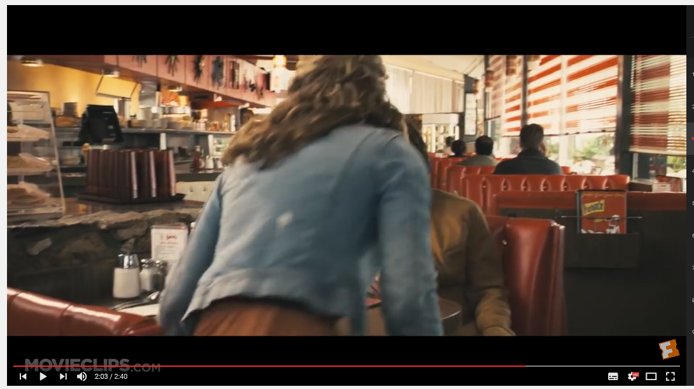
https://www.youtube.com/watch?annotation_id=annotation_381935&feature=iv&list=PLCDA5EF834647EEED&src_vid=TW8ZML5OvXs&v=aUWOzyo-Kec

